Slide 1
Biochem 3BP3 RNA-Seq, ChIP-Seq, Bisulfite-Seq

Slide 2
Biochem 3BP3 RNA-Seq, ChIP-Seq, Bisulfite-Seq
gene expression
gene regulation
gene silencing
aka “epigenetics”

Slide 3
Gene Expression
5’
3’
DNA
exon
exon
exon
transcription, splicing
5’
3’
mRNA
AAAAAAA
translation
protein

Slide 4
Gene Expression
5’
3’
DNA
exon
exon
exon
TF binding site

Slide 5
Gene Expression
TF
5’
3’
DNA
exon
exon
exon
TF binding site

Slide 6
Gene Expression
RNApol
TF
5’
3’
DNA
exon
exon
exon
TF binding site

Slide 7
Gene Expression
RNApol
TF
5’
3’
DNA
exon
exon
exon
TF binding site
transcription, splicing
5’
3’
mRNA
AAAAAAA
translation
protein

Slide 8
Gene Expression
methylation
5’
3’
DNA
exon
exon
exon
TF binding site

Slide 9
Gene Expression
TF
methylation
5’
3’
DNA
exon
exon
exon
TF binding site
gene silencing via genomic DNA methylation

Slide 10
Transcription, Regulation, Epigenetics
RNA-Seq is a NGS method to estimate the abundance of mRNA transcripts in the transcriptome
ChIP-Seq is a NGS method to detect transcription factor or other DNA-binding protein binding sites in the genome
Bisulfite-Seq is a NGS method to determine methylation patterns in the genome

Slide 11
Transcription, Regulation, Epigenetics
Each method relies on the generation of millions of NGS reads
These are DIRECT methods!
How the reads are generated determines what is being measured – novel library preparation methods
All three methods rely heavily on the alignment of short NGS reads to reference genome sequences using variants of the Burrows-Wheeler Transform (e.g. BWA, Tophat, HiSAT2, etc.)
Depth of sampling of NGS reads will vary among replicates and the data thus require normalization
Some of the methods rely heavily upon use of technical controls (i.e. a control for the methodology, not the experimental conditions)

Slide 12
What is a technical control?
A technical control corrects for steps in the assay being used. It removes background noise or bias in the technology, resulting in corrected values being used for statistical tests.
In the microarray lab, we made technical corrections without explicit use of technical controls:
Background subtraction in microarrays to remove background fluorescence of glass
Non-linear normalization across microarrays due to loading error
An experimental control corrects for steps in the experiment to focus the observed values on the effect being studied. For example:
Zebrafish embryos exposed to TCDD (dissolved in DMSO)
Zebrafish embryos exposed to DMSO only

Slide 13
RNA-Seq
5’
3’
mRNA
AAAAAAA
Isolate mRNA using the same methods as for microarray experiments
Fragment the mRNA sample into small pieces of mRNA (or cDNA), link to Illumina adapators, and perform high-throughput DNA sequencing
Non-biased sampling of the transcriptome
mRNA fragments are randomly distributed across transcripts
abundance of fragments is reflective of actual transcript abundance

Slide 14
RNA-Seq
5’
3’
mRNA
AAAAAAA
As in genome sequencing, transcriptome sequencing assembly is improved by using Illumina mate-pairs (i.e. forward & reverse reads)
Unlike genome sequencing, length of NGS reads is less important
using small fragment size libraries
assembly challenge is local (i.e. a transcript) instead of global (i.e. a genome)
depth of sampling is critical for accurate assessment of transcriptome abundance and there is more to sample than whole-genome shotgun
often see 2 x 50 bp Illumina sequencing = cost less = more depth

Slide 15
RNA-Seq
NGS reads are mapped to the genome sequence using mRNA specific variants (e.g. HiSAT2) of the Burrows-Wheeler Transform since RNA-Seq reads will not contain intron sequences
RNA-Seq thus not only measures transcript abundance but it also helps define transcript models – intron/exon boundaries – as well as detect alternate splicing

Slide 16
RNA-Seq
intron
intron

Slide 17
RNA-Seq
Since each RNA-Seq mate pair is generated from a single mRNA fragment, a mate-pair is the base unit for measurement of transcript abundance
Linear normalization methods adjust for sampling effort and gene size; FPKM = fragments per kilobase of transcript per million mapped reads; for example:
11,000,000 RNA-Seq reads generated
8,300,000 RNA-Seq reads mapped to genome
783 fragments mapped to CYP19
CYP19 transcript is 913 bp
FPKM = 783 / (913/1000) / (8300000 / 1000000) = 103.32
As observed in microarray experiments, abundance plots between samples are often non-linear, requiring more sophisticated normalization (next slide)
Final normalized data sets are submitted to standard statistical tests very similar to single-dye microarray data
avoid use of fold-change statistics
considerable focus on multiple tests and false discovery rates

Slide 18
RNA-Seq Normalization
Single channel microarrays – Cy3 intensity converted to a number by Feature Extraction: bigger number = more mRNA
RNA-Seq – mRNA fragments (i.e. mate pairs) aligned to genes and # fragments per gene counted: higher count = more mRNA
In microarrays, we had to normalize for loading error: different amounts of Cy3 labeled cDNA pipetted onto each microarray
In RNA-Seq, after removal of low quality sequence based on PHRED values plus exclusion of contaminant sequences that do not map to the reference genome, each library ends up sequenced to slightly different depths: this is equivalent to loading error
Normalization via Rank Invariant Probes would work for both single channel microarrays and RNA-Seq data
However, RNA-Seq normalization algorithms have advanced further…

Slide 19
DESeq2 for RNA-Seq
DESeq2 performs non-linear normalization of RNA-Seq data using the negative binomial distribution & local regression
Normalization algorithm down-plays highly expressed or highly variable genes and thus reduces Type I Error (false discovery), particularly for lowly or highly expressed genes
DESeq2 can perform both normalization and significance tests
DESeq2 significance testing has some of the best additional FDR correction algorithms for RNA-Seq as well as use of General Linear Models to handle complex experimental designs
Pre-test exclusion of non-variable genes to reduce the number of tests performed
Benjamini and Hochberg correction for FDR for the remaining genes

Slide 20
DESeq2 for RNA-Seq
DESeq2 performs non-linear normalization of RNA-Seq data using the negative binomial distribution & local regression
Normalization algorithm down-plays highly expressed or highly variable genes and thus reduces Type I Error (false discovery), particularly for lowly or highly expressed genes
DESeq2 can perform both normalization and significance tests
DESeq2 significance testing has some of the best additional FDR correction algorithms for RNA-Seq as well as use of General Linear Models to handle complex experimental designs
Pre-test exclusion of non-variable genes to reduce the number of tests performed
Benjamini and Hochberg correction for FDR for the remaining genes

Slide 21
ChIP-Seq
TF
5’
3’
DNA
exon
exon
exon
TF binding site
ChIP-Seq = chromatin immunoprecipitation (ChIP) assays with NGS
Goal is to determine locations of DNA binding for a specific protein

Slide 22
ChIP-Seq
DNA extracted from cells – some of the DNA will have proteins attached
formalin crosslink DNA-protein so proteins cannot fall off
sonicate to destroy DNA not crosslinked to a protein
aliquot soluble chromatin
immuno-precipitate using an antibody specific to target protein
reverse formalin crosslinks
sequence

Slide 23
ChIP-Seq
NGS reads acquired from ChIP-Seq should only be from the locations where the target protein was bound to the genome
The quality and specificity of the antibody is paramount!
ChIP-Seq data is often noisy due to low rates of non-specificity
Background noise from incomplete sonication of non-bound DNA is corrected by use of a technical control
SAMPLE
TECHNICAL CONTROL
DNA extracted from cells
crosslink DNA-protein
sonicate
aliquot soluble chromatin
immuno-precipitate
reverse formalin crosslinks
sequence
DNA extracted from cells
crosslink DNA-protein
sonicate
aliquot soluble chromatin
immuno-precipitate
reverse formalin crosslinks
sequence
compare

Slide 24
ChIP-Seq
NGS reads are mapped to the genome sequence the Burrows-Wheeler Transform
Peak finding algorithms are used to find small regions in the genome where the sample has more aligned reads than the technical control

Slide 25
ChIP-Seq
For each region found in each sample or input control, perform linear normalization = # reads in region per million mapped reads
Determine fold enrichment relative to technical control, e.g. for the peak found upstream of CYP1A1
SAMPLE
TECHNICAL CONTROL
11,000,000 NGS reads
8,400,000 mapped reads
273 reads in peak
Normalized peak height = 273 / (8400000/1000000) = 32.5
13,000,000 NGS reads
7,400,000 mapped reads
23 reads in peak
Normalized peak height = 23 / (7400000/1000000) = 3.1
compare
32.5 / 3.1 = 10.45 fold enrichment

Slide 26
ChIP-Seq
Most ChIP-Seq papers are exploratory – where are the most enriched regions in the genome?
Reduced NGS sequencing costs leading to replicated experiments
Statistical analysis of difference in fold enrichment among sites
Familiar false discovery rate issues
Enriched sites of interests undergo secondary analysis
What genes are they upstream of? Does this help elucidate the regulatory role of the target protein?
What are the sequences of the putative binding sites? Can we build a PSSM to search for more such binding sites in genomes?
Experimental validation by site-directed mutation

Slide 27
Bisulfite-Seq
TF
methylation
5’
3’
DNA
exon
exon
exon
TF binding site
The goal of this method is to detected methylated regions in the genome
Combining these data with RNA-Seq and ChIP-Seq among tissues or experimental conditions can lead to a comprehensive understanding of gene regulation
Whole genome bisulfite sequencing (WGBS) to assess differences in genome-wide cytosine methylation patterns, including CpG, CHH, & CHG

Slide 28
Bisulfite-Seq
Bisulfite-Seq is essentially a whole genome shotgun sequencing method, i.e. sampling Illumina mate-pairs throughout the genome
However, bisulfite conversion during library preparation changes unmethylated cytosines to uracil
SAMPLE
TECHNICAL CONTROL
DNA extracted from cells
bisulfite treatment
genome library construction
sequence
DNA extracted from cells
bisulfite treatment
genome library construction
sequence
compare
methylated cytosines: the sample will have cytosines (C) and the technical control will have cytosines (C)
unmethylated cytosines: the sample will have thymines (T) while the technical control will have cytosines (C)

Slide 29
Bisulfite-Seq
Me
Me
Me
in the sample DNA
ACGACTACGCCTTGCCCAGTCAACTG
bisulfite seq data
ACGATTATGCTTTGTTCAGTTAATTG
input control seq data
ACGACTACGCCTTGCCCAGTCAACTG
methylated cytosines: sample will have cytosines (C) and the technical control will have cytosines (C)
unmethylated cytosines: sample will have thymines (T) while the technical control will have cytosines (C)

Slide 30
Bisulfite-Seq
Me
Me
Me
in the sample DNA
ACGACTACGCCTTGCCCAGTCAACTG
bisulfite seq data
ACGATTATGCTTTGTTCAGTTAATTG
input control seq data
ACGACTACGCCTTGCCCAGTCAACTG
Me
Me
Me
conclusion
ACGACTACGCCTTGCCCAGTCAACTG
methylated cytosines: sample will have cytosines (C) and the technical control will have cytosines (C)
unmethylated cytosines: sample will have thymines (T) while the technical control will have cytosines (C)

Slide 31
Bisulfite-Seq
NGS reads are mapped to the genome sequence the Burrows-Wheeler Transform
DNA methylation levels inferred (based on frequency of Cs or Ts aligned to Cs in the genome) using Bis-SNP variant callers
Depth of coverage is critical to confidently predict methylation sites
Whole genome bisulfite sequencing (WGBS) is still somewhat expensive given the costs of sequencing an animal genome, but expected to become more prevalent as NGS costs drop
For example, McMaster mouse WGBS of a sample + technical control = ~$3000
Reduced representation bisulfite sequencing (RRBS) is popular
MspI restriction enzyme is used during library construction to enrich for the areas of the genome that have a high CpG content
CpG biased sampling of the genome requires less sequencing

Slide 32
Conclusions
Inventive molecular biology during NGS library construction allows DNA sequencing to be used as an assay for different aspects of biology
If you have a method to isolate or enrich a sample for a specific target DNA or RNA population, it can be adapted for NGS analysis at the whole-genome level
Normalization and false discovery rate issues are generally the same throughout the methods
Use of novel technical controls requires novel algorithm development, e.g. peaking finding in ChIP-Seq, Bis-SNP variant callers for methylation patterns

Slide 33
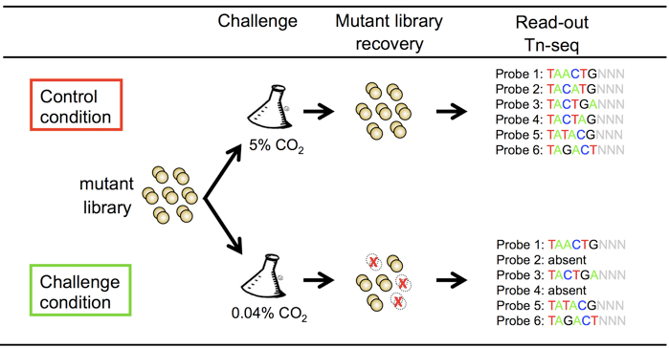
Conclusions
Expect to see lots of new assays develop over the next few years, e.g transposon sequencing (Tn-seq) to assay bacteria fitness, gene interactions, gene function

Slide 34
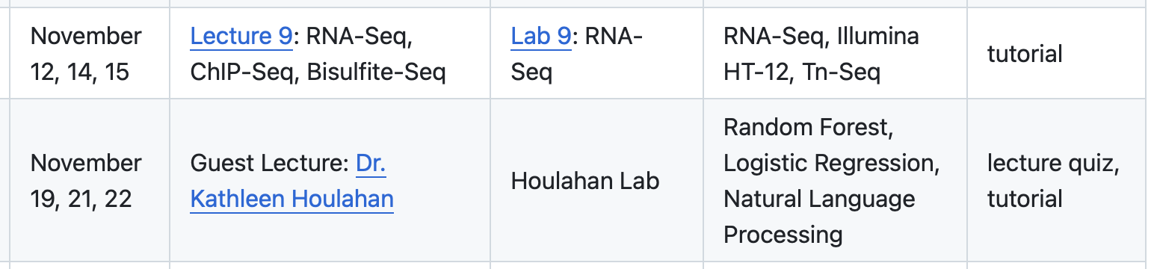
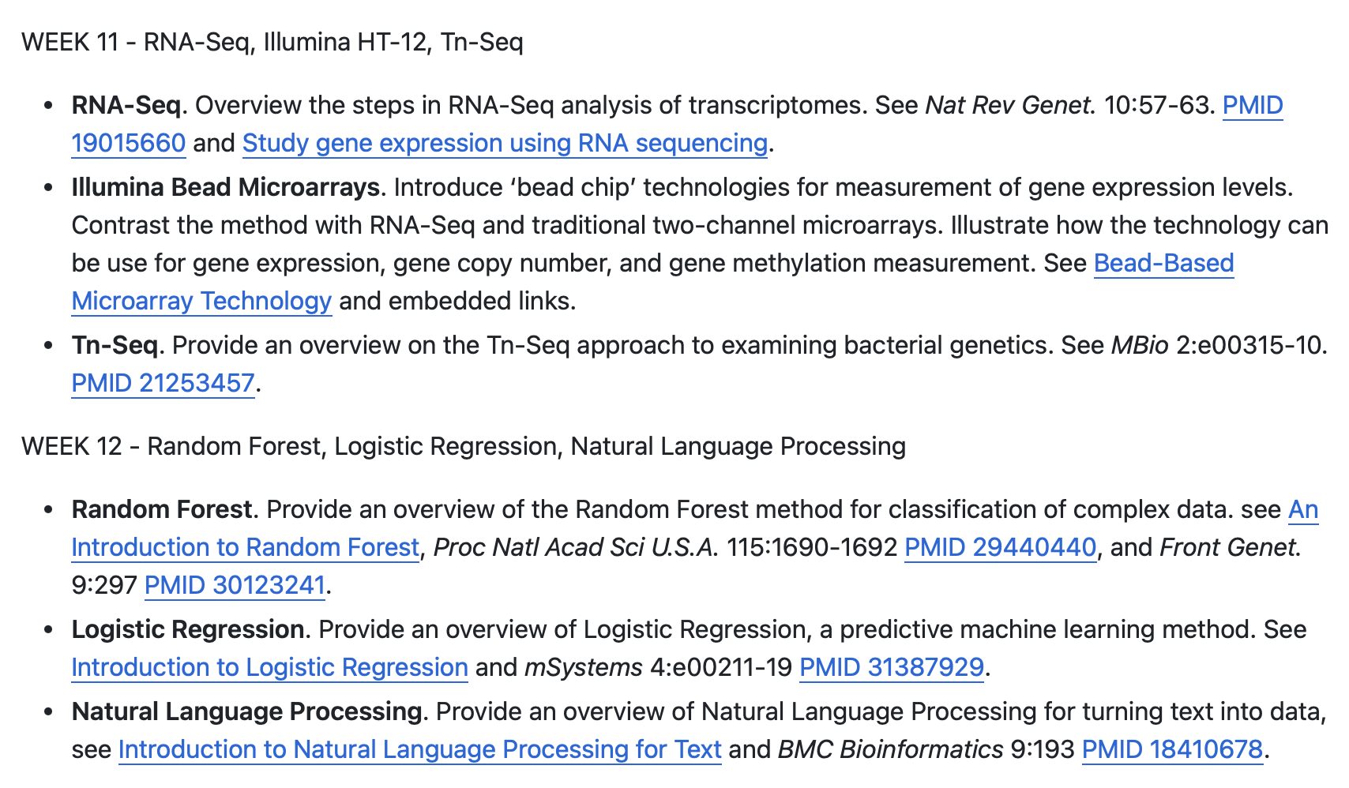
Next two weeks…

